Slide 1
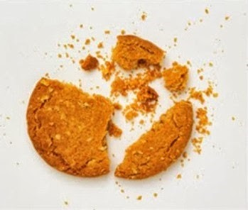

Test Automation Using Selenium
Fair Hike Academy
That’s the way the cookie crumbles!
Session 9: Java Programming using Eclipse IDE
Mentor : Naresh Vulli, CSTE, PAHM.
fairhike@gmail.com www.fairhike.blogspot.com | www.facebook.com/fairhike

Slide 2
Today’s Topics
Recap
Eclipse IDE
Installation
JRE Library Setup
Project
Package
Class
Writing a Java Program
Executing Java Program
Takeaways or Exercise

Slide 3

Eclipse IDE
Eclipse is famous for our Java Integrated Development Environment (IDE). It contains a base workspace and an extensible plug-in system for customizing the environment.
Versions of Eclipse have been named after different celestial bodies: Europa, Ganymede, Callisto, Galileo, Luna, and recently, Mars.

Slide 4
Installation
http://www.eclipse.org/downloads/packages/eclipse-ide-java-developers/mars2
Download Links – Select 32-bit / 64-bit
Determine using “Java –version” command
Click Download
Extract the zip file to a folder
Launch Eclipse application directly

Slide 5
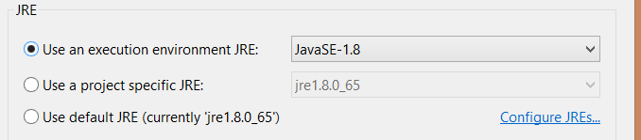
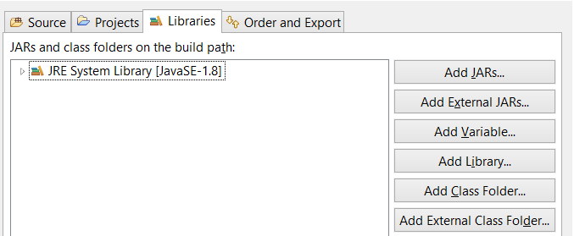
JRE Library Setup

Slide 6
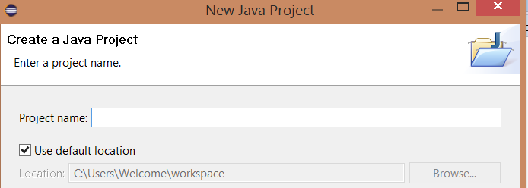
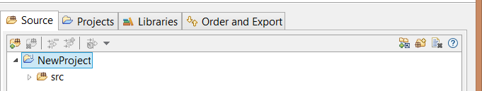
Java Project
File → New → Java Project

Slide 7
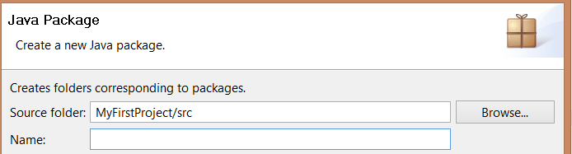
Java Package
Hierarchical file system to manage source and class files
File → New → Package

Slide 8
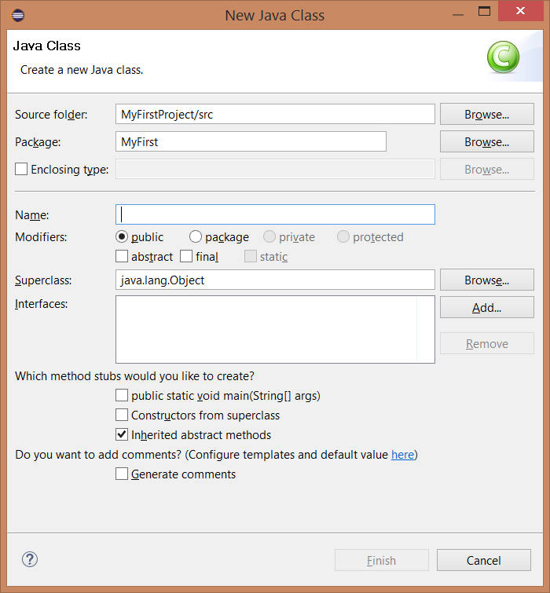
Java Class
File → New → Class

Slide 9
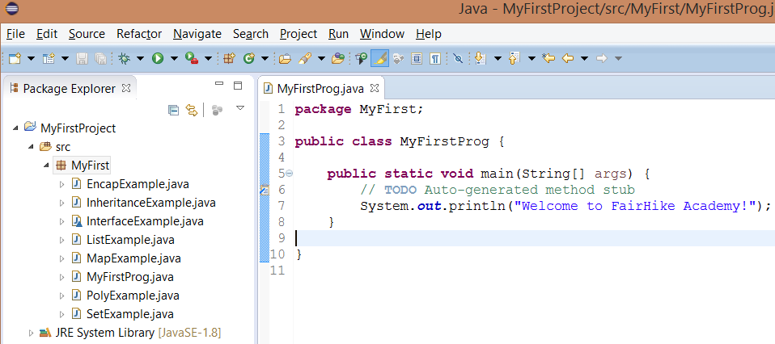
Writing a Java program

Slide 10
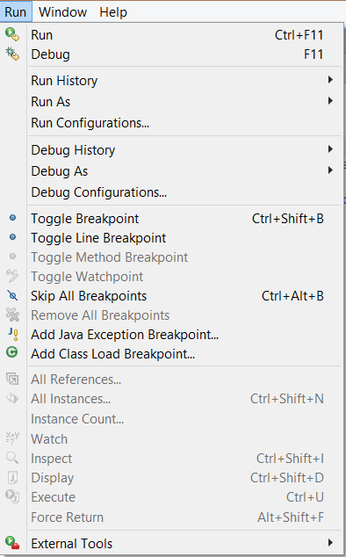
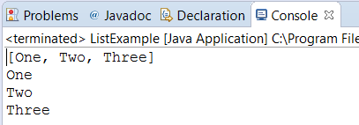
Running Java program

Slide 11
Takeaway or Exercise
Execute all Java example files using Eclipse
Explore different features available with Eclipse

Slide 12
Q & A

Slide 13
Thank You ☺

